Slide 1
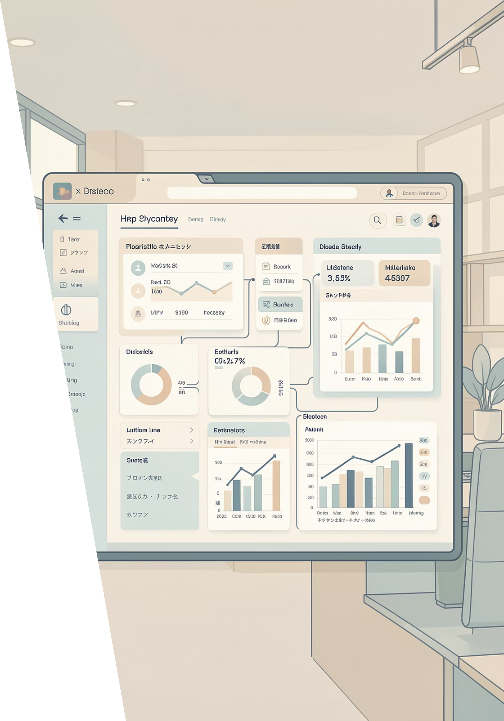
Modular HR Digital Platform Centered on HR CORE
A next-generation, AI-powered human resources ecosystem that transforms workforce management from operational necessity to strategic advantage.

Slide 2
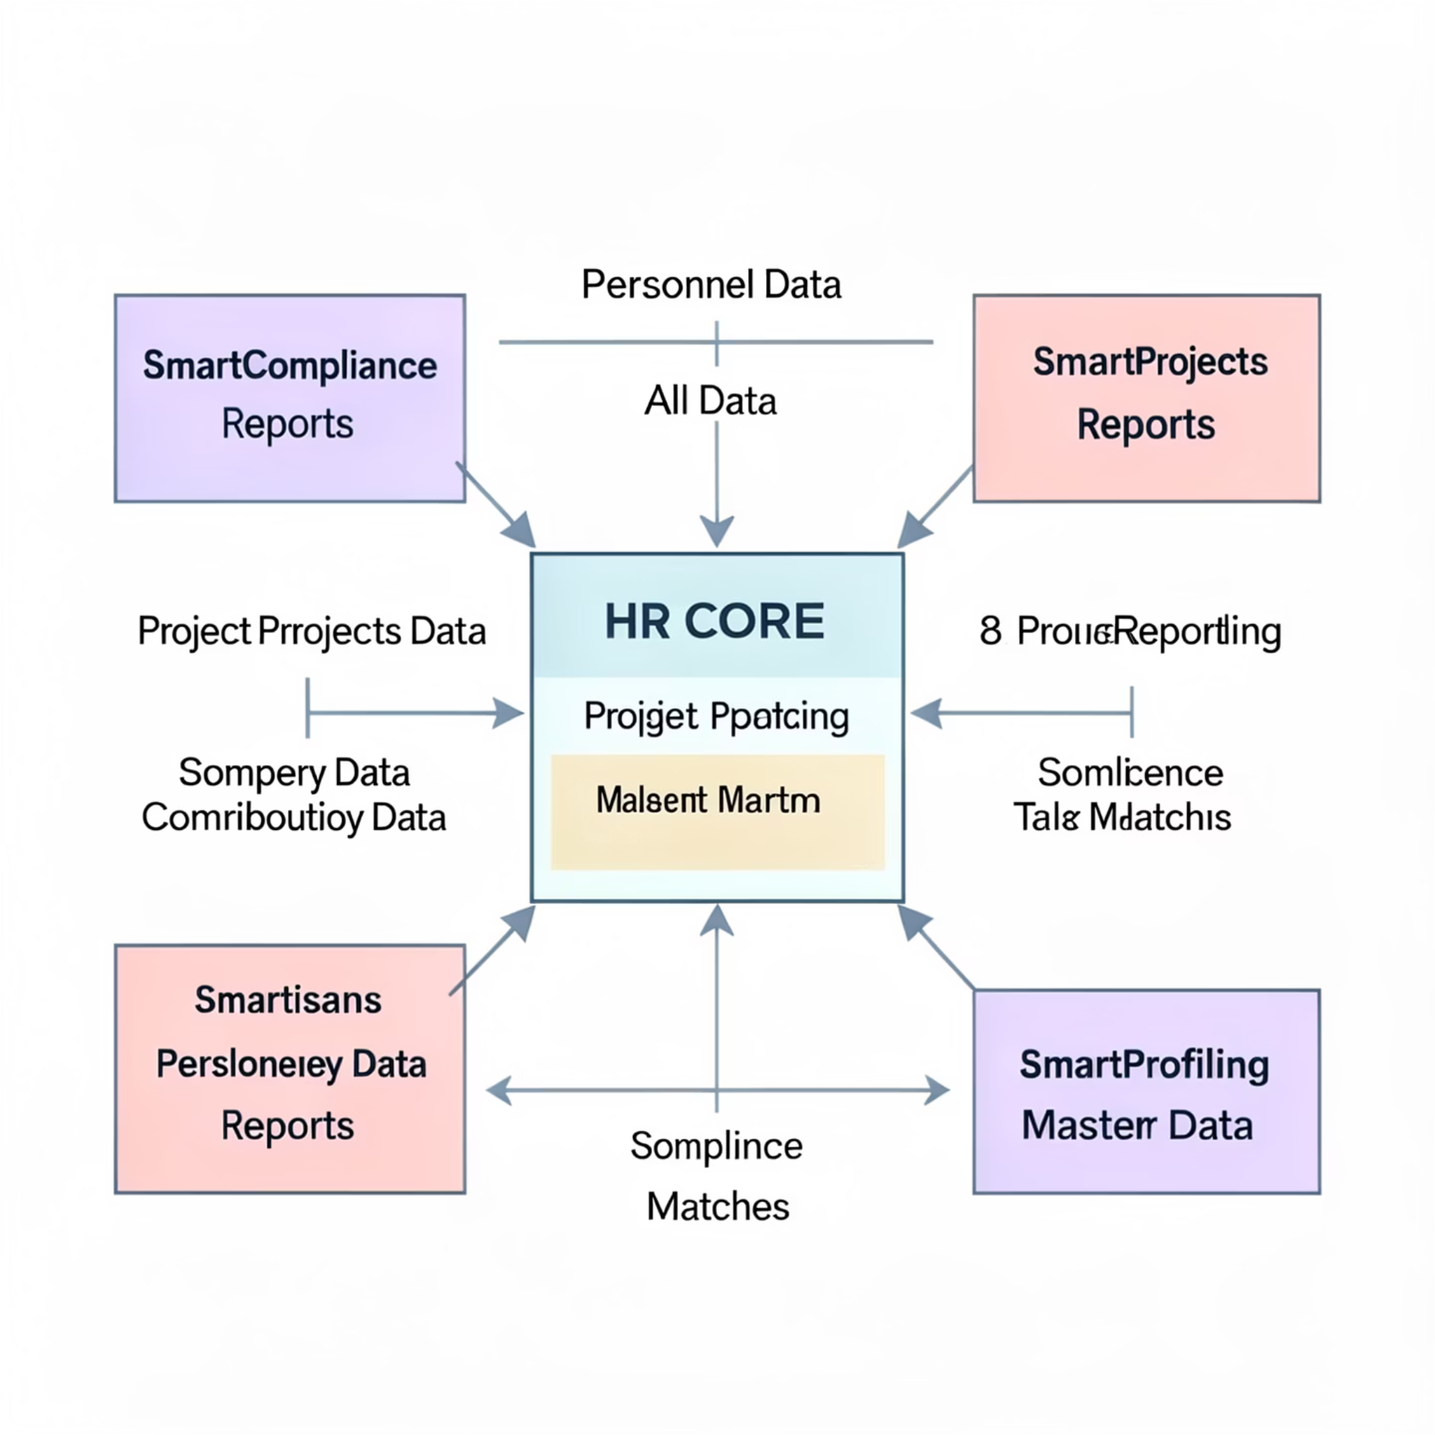
Modular HR Platform Architecture
This architecture highlights HR CORE as the central hub, enabling seamless integration and strategic enhancement across all HR functions through specialized modules, with clear data dependencies and outputs.
HR CORE (Center)
Four Modules
Personnel Data
Salary Data
Basic Reporting
Master Data
SmartCompliance (Top)
Receives: All Data
Outputs: Compliance Reports
SmartProjects (Top Right)
Receives: Project Data
Outputs: Project Contribution Data
Smartisans (Bottom Right)
Receives: Competency Data
Outputs: Development Plans
SmartProfiling (Left)
Receives: Personnel Data
Outputs: Talent Matches

Slide 3
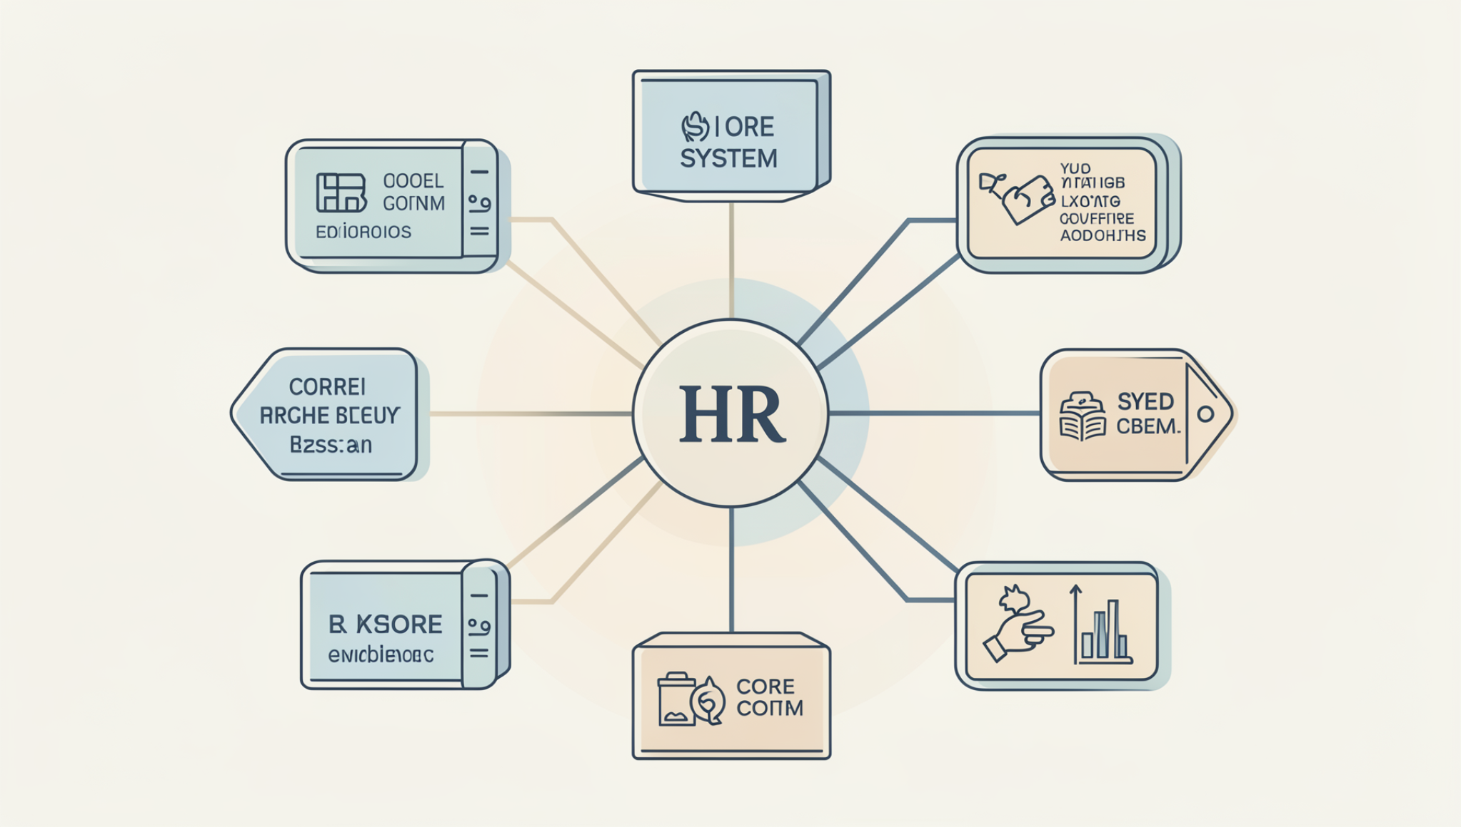
FOUNDATION
The Heart of the Platform: HR CORE
Personnel management, payroll and tax processing, and essential reporting form the foundational backbone of your entire HR ecosystem.
Single Source of Truth
Operational Excellence
Seamless Integration
Ensures data accuracy and integrity across all HR functions
Streamlines compliance and drives efficiency at scale
Enables advanced modular components to unlock workforce optimization

Slide 4
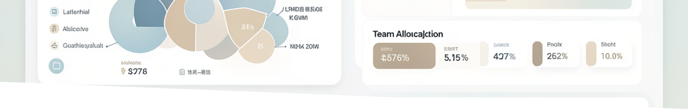

RESOURCE OPTIMIZATION
SmartProjects: Intelligent Human Resource Allocation & Contribution Evaluation
Fine-Grained Resource Intelligence
Dynamic Planning
Impact Tracking
SmartProjects uses detailed project contribution data to optimize how talent is deployed across your organization. AI-driven assessment evaluates individual and team impact on project outcomes in real-time.
Align workforce deployment with shifting business priorities
Measure contribution at the most granular level
Optimal Allocation
Put the right people on the right projects at the right time

Slide 5



COMPLIANCE
SmartCompliance: Embedded Intelligent Compliance Module
Always-On Regulatory Protection
1
2
Operating as a semi-independent module, SmartCompliance ensures regulatory adherence across all HR operations with AI-powered monitoring and proactive risk management.
Automated Checks
Risk Alerts
Continuous compliance monitoring without manual effort
Proactive warnings before issues become problems
3
Audit Readiness
Maintain documentation and evidence trails automatically
SmartCompliance reduces legal risks and administrative burden, allowing your HR team to focus on strategic initiatives rather than regulatory paperwork.

Slide 6

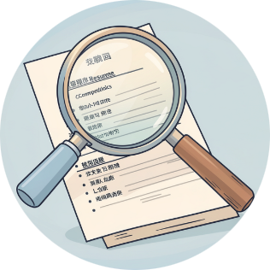
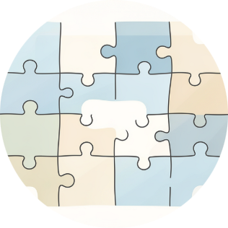
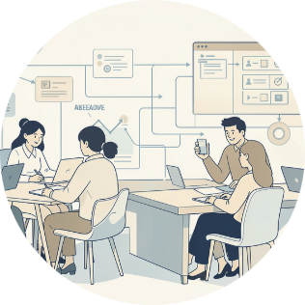
AI-POWERED
SmartProfiling: AI-Powered Competency Matching Tool
Precision Talent Matching at Scale
SmartProfiling analyzes job competency requirements and candidate real competencies—both internal and external—to create highly accurate talent matches. By leveraging AI to understand the nuances of role requirements and individual capabilities, the system improves hiring quality and internal placement decisions.
Deep Competency Analysis
Intelligent Matching
Workforce Agility
Matches talent profiles to roles with unprecedented precision
Enables rapid, strategic talent deployment across the organization
AI parses and evaluates true skill levels beyond keywords

Slide 7
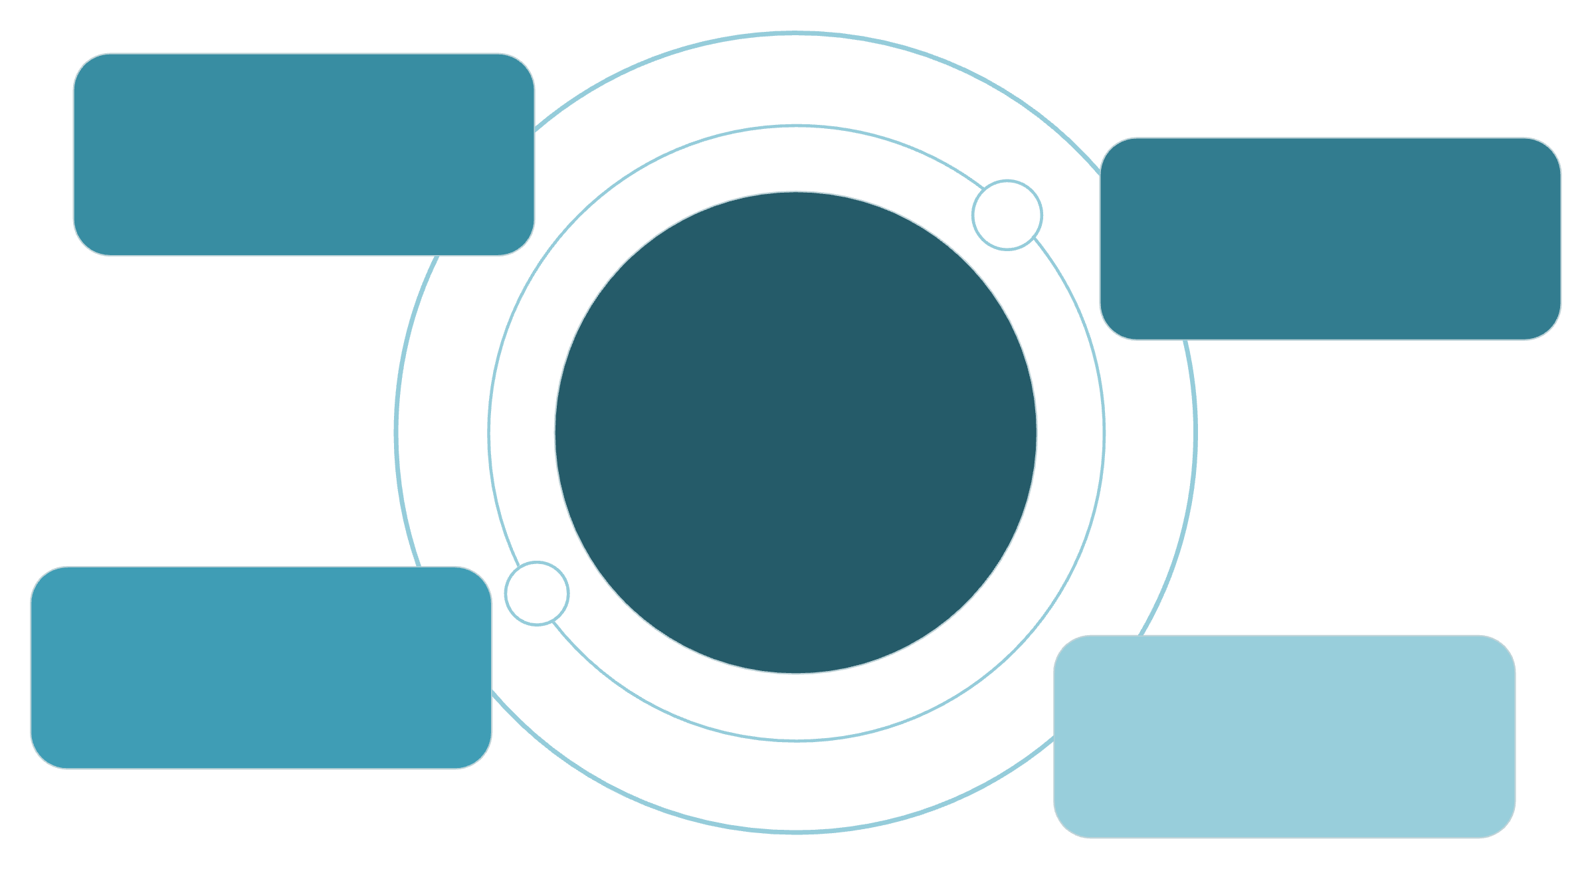
Building a Flexible, Scalable HR Ecosystem
HR CORE anchors a modular, composable platform that adapts seamlessly to evolving business needs. Each module integrates effortlessly, enabling rapid innovation and personalized employee experiences that drive engagement and performance.
Talenturbo
Assessment and insights
SmartProjects
Resource allocation
HR CORE
Modular hub with bidirectional data flow
Smartisans
Learning & development
SmartCompliance
Regulatory controls
Together, these intelligent modules transform HR from an administrative function into a strategic driver of organizational success, competitive advantage, and sustainable growth.
6
1
100%
Integrated Modules
Unified Platform
Data Integration
Working in harmony
Single source of truth
Seamless information flow

